Slide 1
Data Link
Control
and
Protocols
Acadimic Purpose Only (KIET CN SKK IT VI)

Slide 2
Flow and Error Control
Flow Control
Error Control
The most important responsibilities of the data link layer are flow control and error control. Collectively, these functions are known as data link control.
Acadimic Purpose Only (KIET CN SKK IT VI)

Slide 3

Note:
Flow control refers to a set of procedures used to restrict the amount of data that the sender can send before waiting for acknowledgment.
Acadimic Purpose Only (KIET CN SKK IT VI)

Slide 4

Protocols
11.<number>

Slide 5
NOISELESS CHANNELS
Let us first assume we have an ideal channel in which no frames are lost, duplicated, or corrupted. We introduce two protocols for this type of channel.
Topics discussed in this section:
Simplest Protocol
Stop-and-Wait Protocol
11.<number>

Slide 6

The design of the simplest protocol with no flow or error control
11.<number>

Slide 7

Flow diagram
11.<number>

Slide 8

Design of Stop-and-Wait Protocol
11.<number>

Slide 9

Flow diagram
11.<number>

Slide 10
NOISY CHANNELS
Although the Stop-and-Wait Protocol gives us an idea of how to add flow control to its predecessor, noiseless channels are nonexistent. We discuss three protocols in this section that use error control.
11.<number>

Slide 11
Note:
Error control in the data link layer is based on automatic repeat request(ARQ), which is the retransmission of data.
Stop-and-Wait ARQ,Go-Back-N ARQ,and Selective-Repeat ARQ.
Acadimic Purpose Only (KIET CN SKK IT VI)

Slide 12
Flow and Error control Mechanism
Stop-and-Wait ARQ, Go-Back-N ARQ , and Selective-Repeat ARQ.
Acadimic Purpose Only (KIET CN SKK IT VI)

Slide 13
Stop-and-Wait ARQ
Operation
Bidirectional Transmission
Acadimic Purpose Only (KIET CN SKK IT VI)

Slide 14
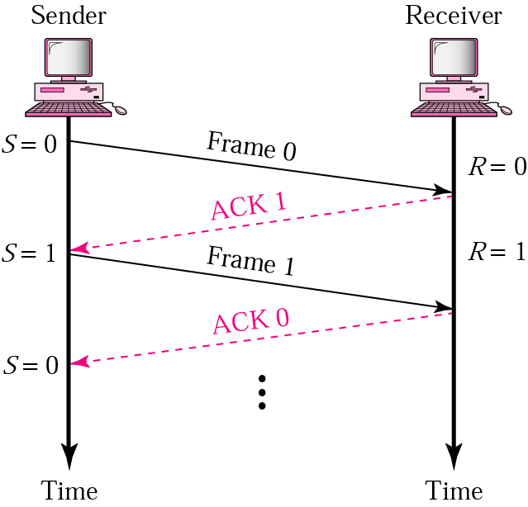
Normal operation
Acadimic Purpose Only (KIET CN SKK IT VI)

Slide 15
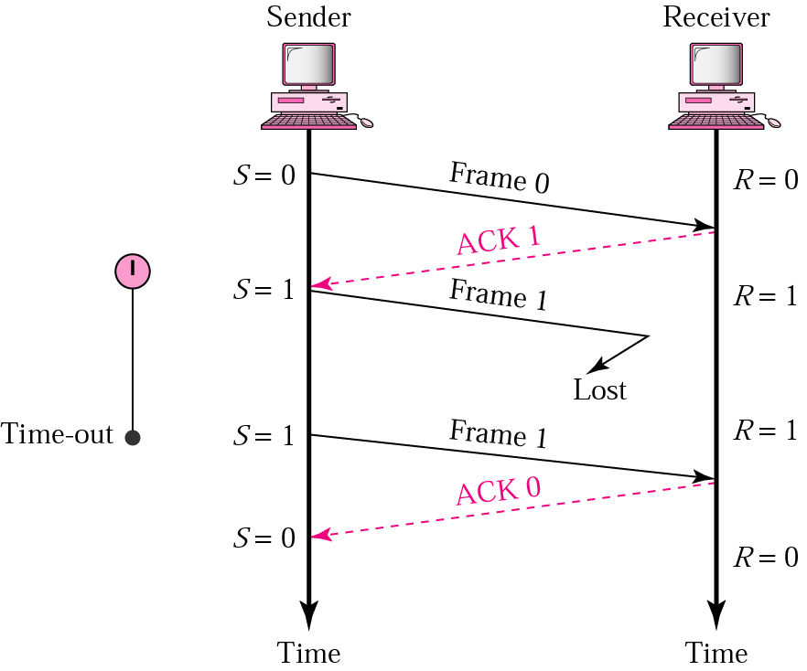
Stop-and-Wait ARQ, lost frame
Acadimic Purpose Only (KIET CN SKK IT VI)

Slide 16
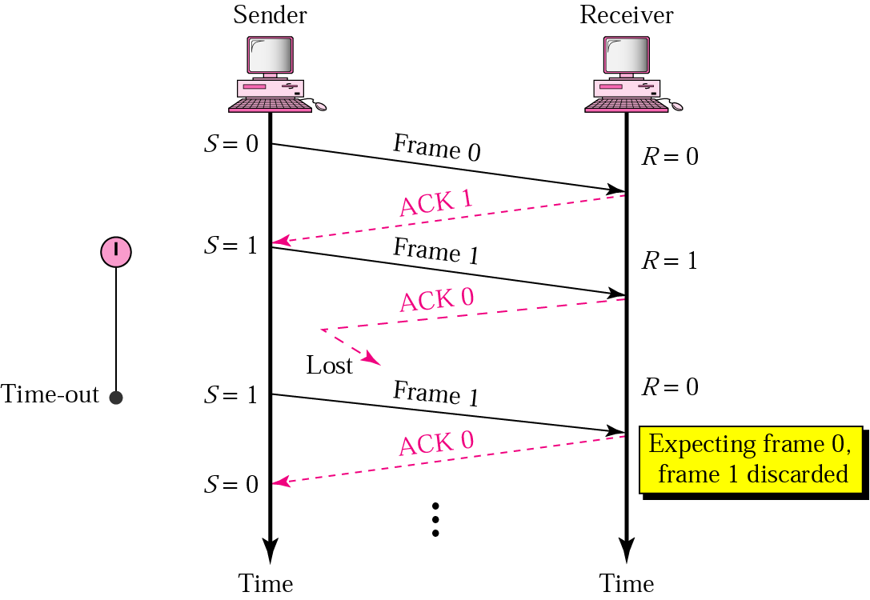
Stop-and-Wait ARQ, lost ACK frame
Acadimic Purpose Only (KIET CN SKK IT VI)

Slide 17
Note:
In Stop-and-Wait ARQ, numbering frames prevents the retaining of duplicate frames.
Acadimic Purpose Only (KIET CN SKK IT VI)

Slide 18
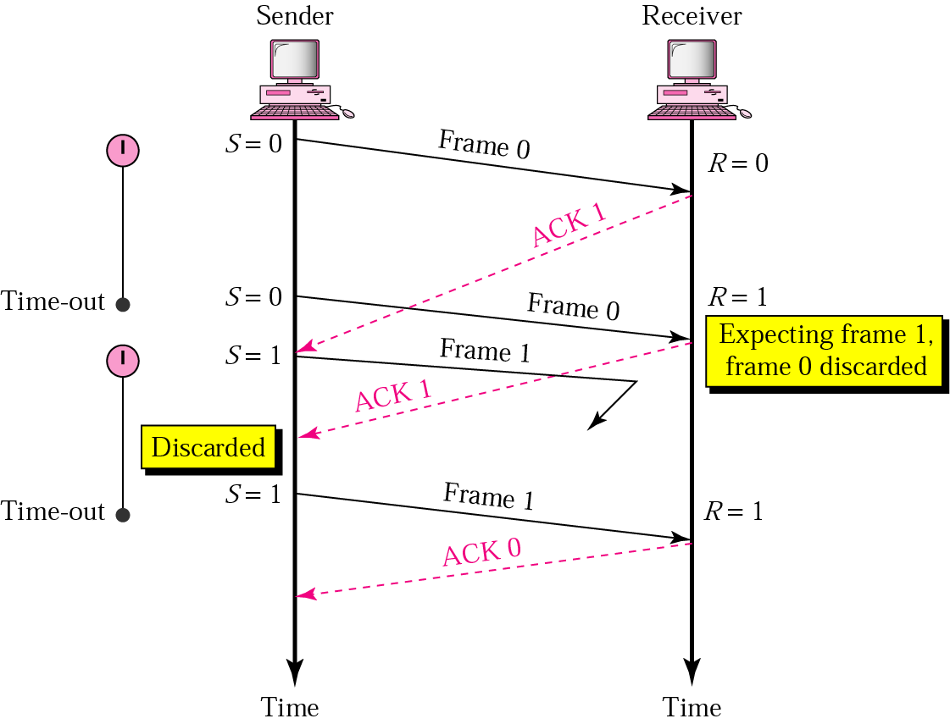
Stop-and-Wait ARQ, delayed ACK
Acadimic Purpose Only (KIET CN SKK IT VI)

Slide 19
Note:
Numbered acknowledgments are needed if an acknowledgment is delayed and the next frame is lost.
Acadimic Purpose Only (KIET CN SKK IT VI)

Slide 20
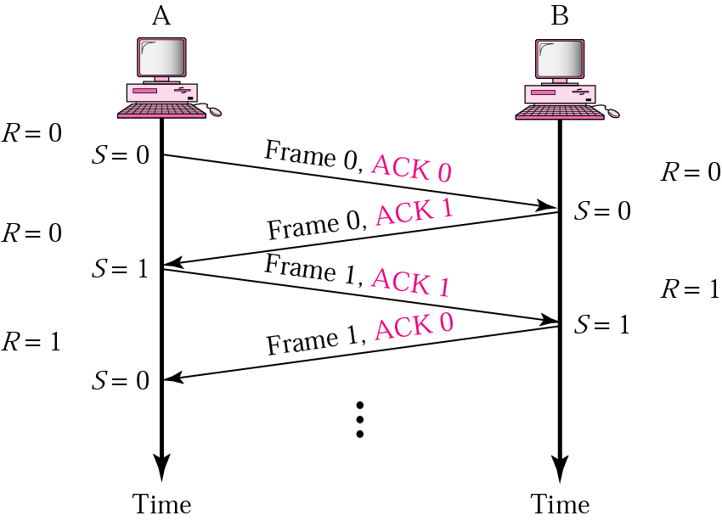
Piggybacking( combine a data Frame with an ACK)
Acadimic Purpose Only (KIET CN SKK IT VI)

Slide 21
Go-Back-N ARQ
Sequence Number (0 to 2^{m}-1)
Sender and Receiver Sliding Window
(sender window size is=2^{m}-1) (Receiver window size=1)
Control Variables
Acknowledgment
Resending Frames
Operation
Acadimic Purpose Only (KIET CN SKK IT VI)

Slide 22
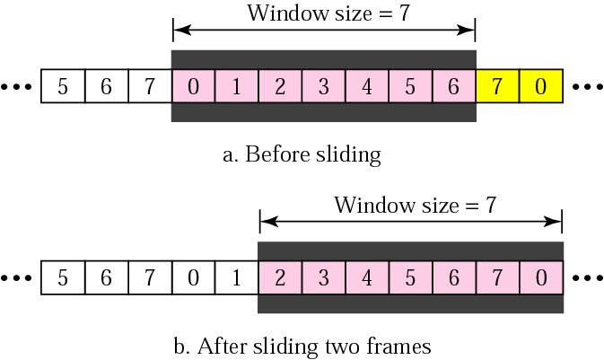
Sender sliding window
Acadimic Purpose Only (KIET CN SKK IT VI)

Slide 23
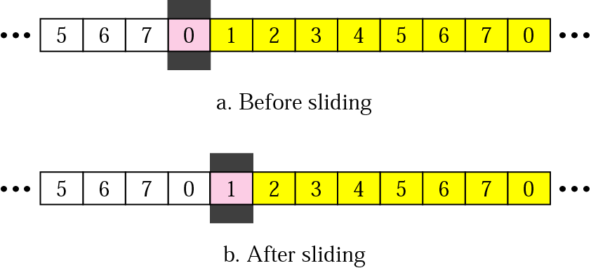
Receiver sliding window
Acadimic Purpose Only (KIET CN SKK IT VI)

Slide 24
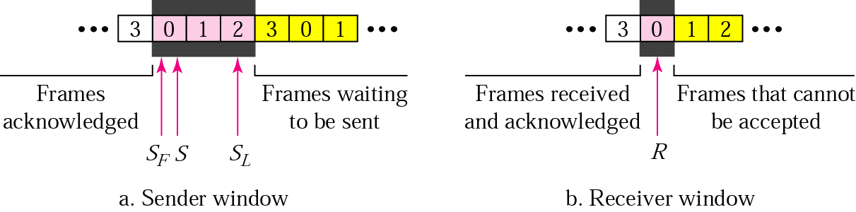
Control variables
Acadimic Purpose Only (KIET CN SKK IT VI)

Slide 25
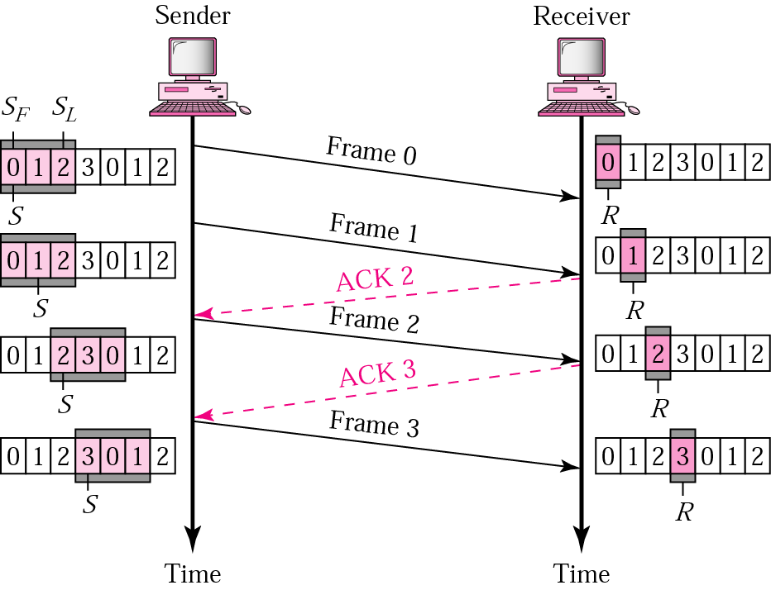
Go-Back-N ARQ, normal operation
Acadimic Purpose Only (KIET CN SKK IT VI)

Slide 26
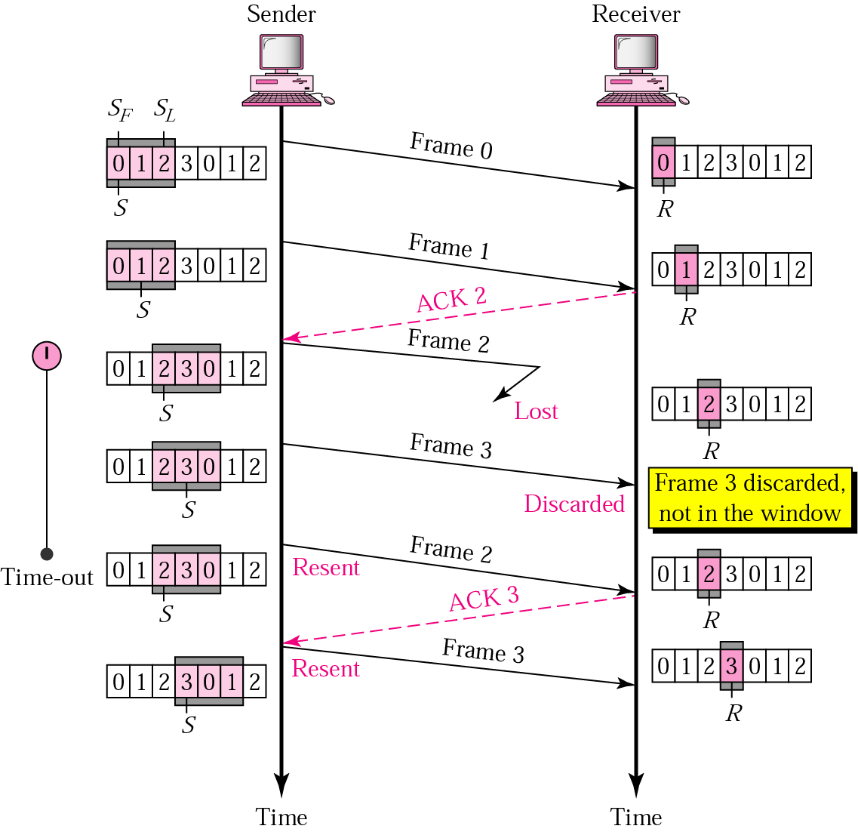
Go-Back-N ARQ, lost frame
Acadimic Purpose Only (KIET CN SKK IT VI)

Slide 27
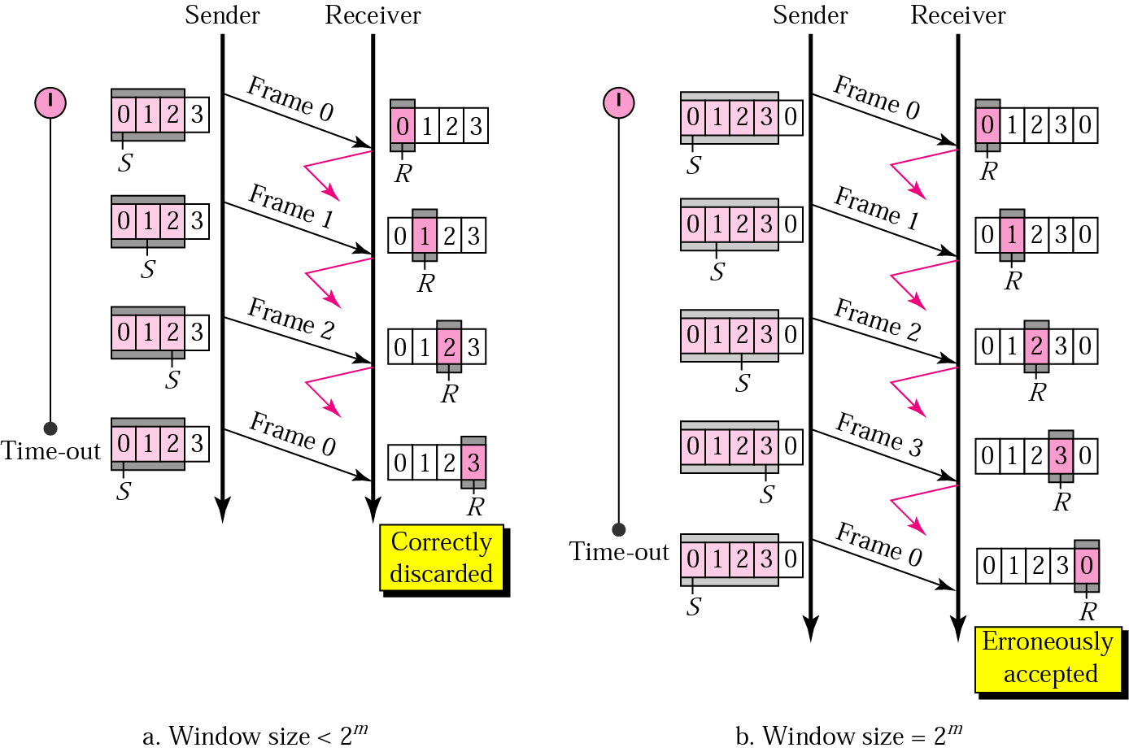
Go-Back-N ARQ: sender window size
Acadimic Purpose Only (KIET CN SKK IT VI)

Slide 28
Note:
In Go-Back-N ARQ, the size of the sender window must be less than 2^{m}; the size of the receiver window is always 1.
Acadimic Purpose Only (KIET CN SKK IT VI)

Slide 29
Selective-Repeat ARQ
Sender and Receiver Windows
Operation
Sender Window Size
Acadimic Purpose Only (KIET CN SKK IT VI)

Slide 30
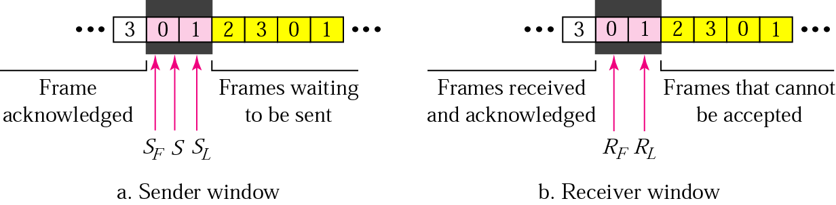
Selective Repeat ARQ, sender and receiver windows
Acadimic Purpose Only (KIET CN SKK IT VI)

Slide 31
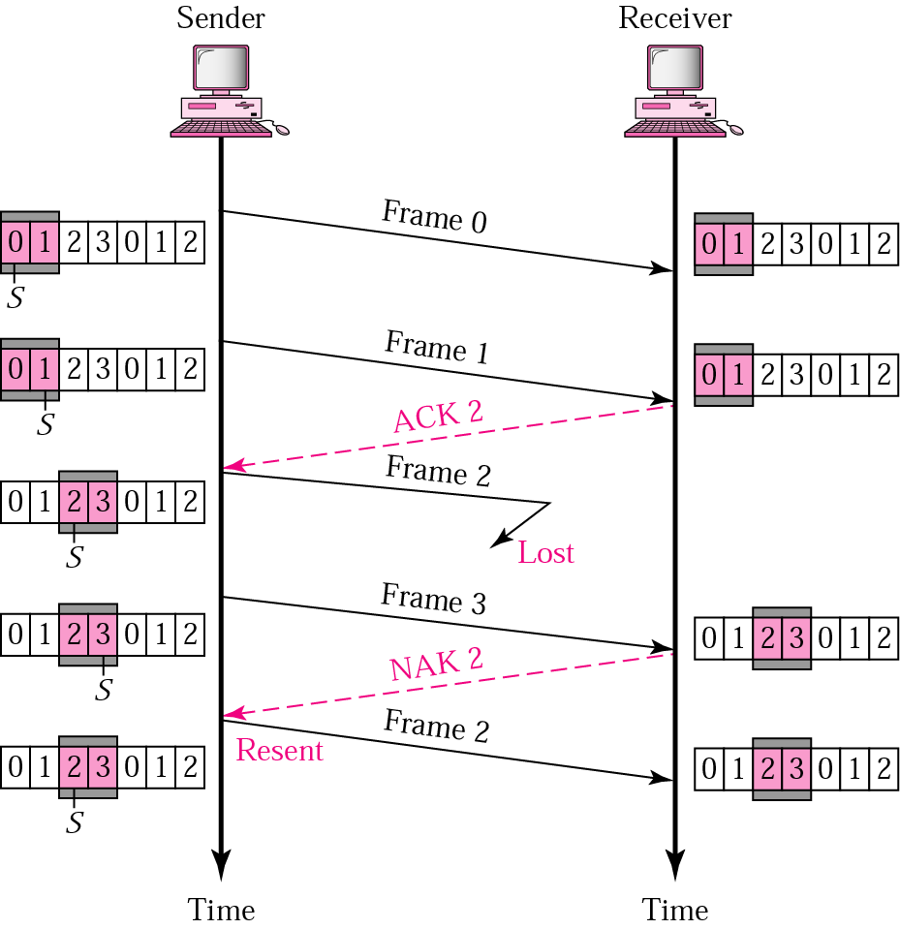
Selective Repeat ARQ, lost frame
Acadimic Purpose Only (KIET CN SKK IT VI)

Slide 32
Note:
In Selective Repeat ARQ, the size of the sender and receiver window must be at most one-half of 2^{m}.
Acadimic Purpose Only (KIET CN SKK IT VI)

Slide 33
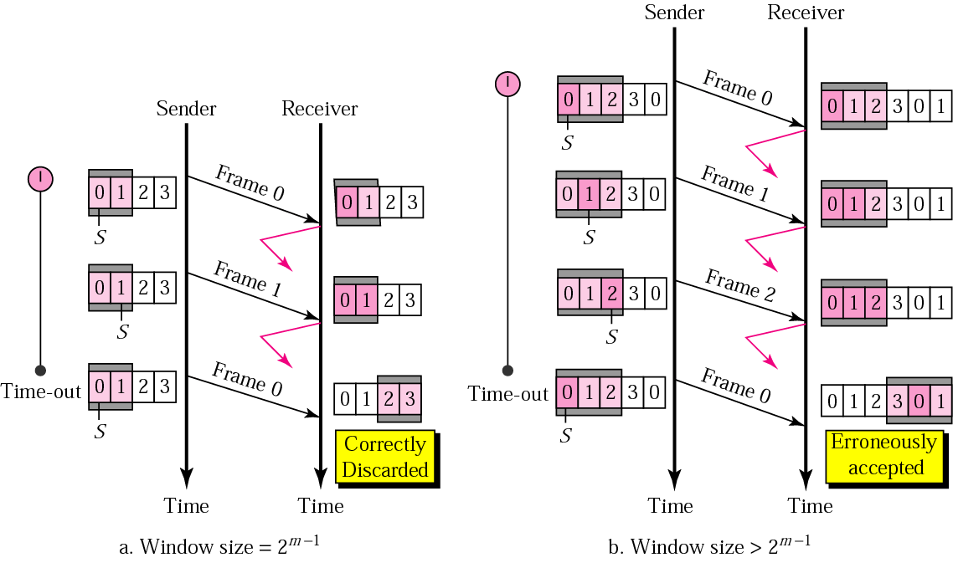
Selective Repeat ARQ, sender window size
Acadimic Purpose Only (KIET CN SKK IT VI)

Slide 34
Example 1
In a Stop-and-Wait ARQ system, the bandwidth of the line is 1 Mbps, and 1 bit takes 20 ms to make a round trip. What is the bandwidth-delay product? If the system data frames are 1000 bits in length, what is the utilization percentage of the link?
Solution
The bandwidth-delay product (frame size) is
1 × 10⁶ × 20 × 10⁻³ = 20,000 bits
The system can send 20,000 bits during the time it takes for the data to go from the sender to the receiver and then back again. However, the system sends only 1000 bits. We can say that the link utilization is only 1000/20,000, or 5%. For this reason, for a link with high bandwidth or long delay, use of Stop-and-Wait ARQ wastes the capacity of the link.
Acadimic Purpose Only (KIET CN SKK IT VI)

Slide 35
Example 2
What is the utilization percentage of the link in Example 1 if the link uses Go-Back-N ARQ with a 15-frame sequence?
Solution
The bandwidth-delay product is still 20,000. The system can send up to 15 frames or 15,000 bits during a round trip. This means the utilization is 15,000/20,000, or 75 percent. Of course, if there are damaged frames, the utilization percentage is much less because frames have to be resent.
Acadimic Purpose Only (KIET CN SKK IT VI)

Slide 36
HDLC
Configurations and Transfer Modes
Frames
Frame Format
Examples
Data Transparency
Acadimic Purpose Only (KIET CN SKK IT VI)

Slide 37
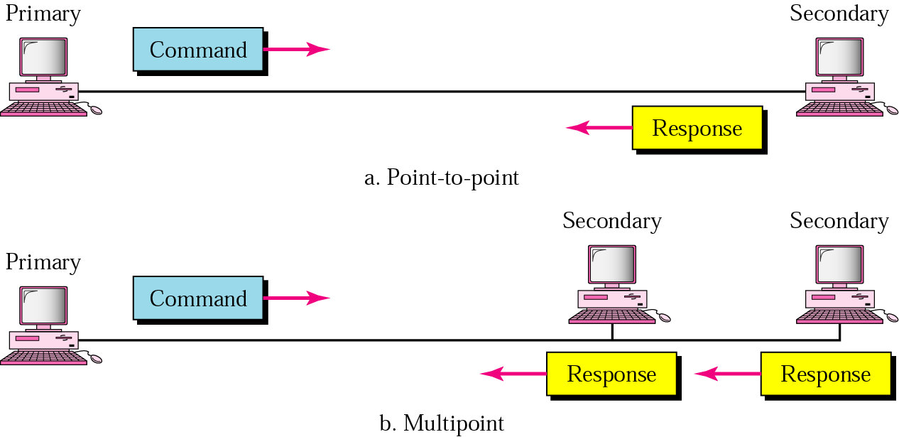
NRM
Acadimic Purpose Only (KIET CN SKK IT VI)

Slide 38
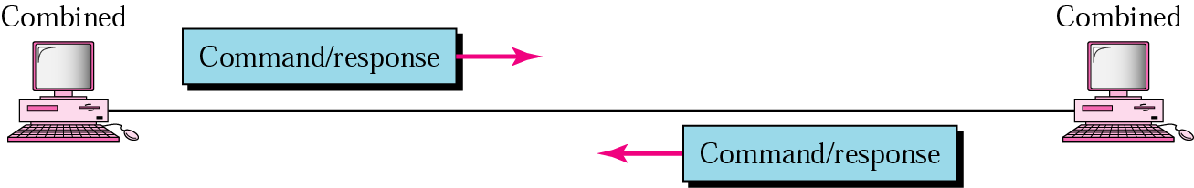
ABM
Acadimic Purpose Only (KIET CN SKK IT VI)

Slide 39
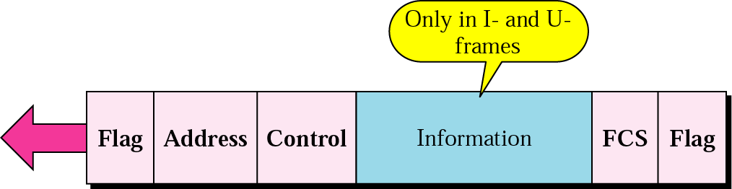
HDLC frame
Acadimic Purpose Only (KIET CN SKK IT VI)

Slide 40
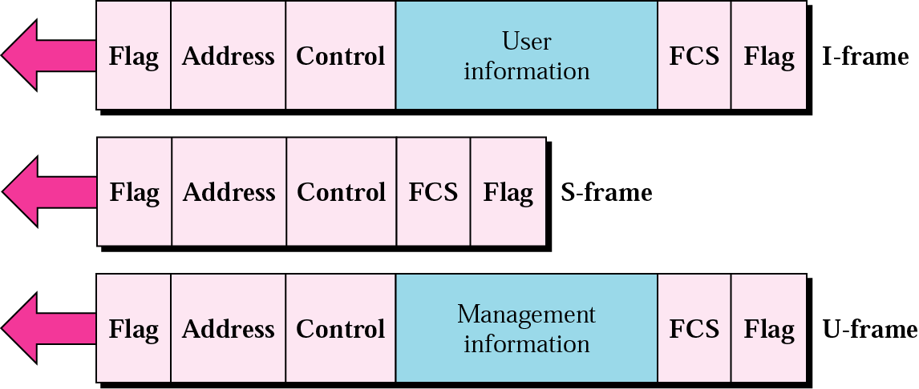
HDLC frame types
Acadimic Purpose Only (KIET CN SKK IT VI)

Slide 41
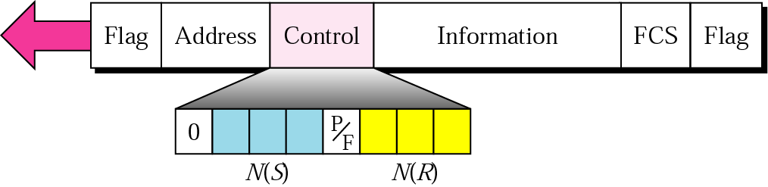
I-frame
Acadimic Purpose Only (KIET CN SKK IT VI)

Slide 42
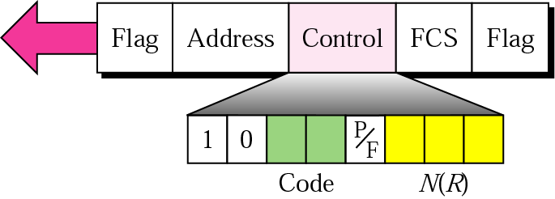
S-frame control field in HDLC
Acadimic Purpose Only (KIET CN SKK IT VI)

Slide 43
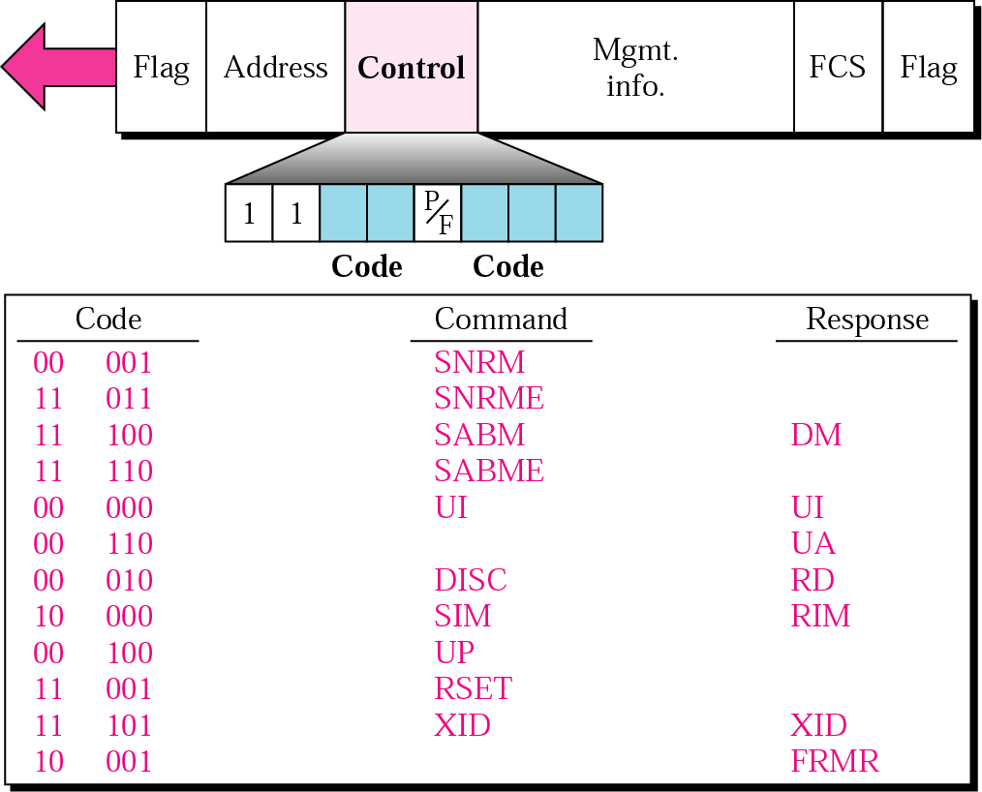
U-frame control field in HDLC
Acadimic Purpose Only (KIET CN SKK IT VI)

Slide 44
U-frame control command and response
Command/response | Meaning
SNRM | Set normal response mode
SNRME | Set normal response mode (extended)
SABM | Set asynchronous balanced mode
SABME | Set asynchronous balanced mode (extended)
UP | Unnumbered poll
UI | Unnumbered information
UA | Unnumbered acknowledgment
RD | Request disconnect
DISC | Disconnect
DM | Disconnect mode
RIM | Request information mode
SIM | Set initialization mode
RSET | Reset
XID | Exchange ID
FRMR | Frame reject
Acadimic Purpose Only (KIET CN SKK IT VI)

Slide 45
Note:
Bit stuffing is the process of adding one extra 0 whenever there are five consecutive 1s in the data so that the receiver does not mistake the
data for a flag.
Acadimic Purpose Only (KIET CN SKK IT VI)

Slide 46
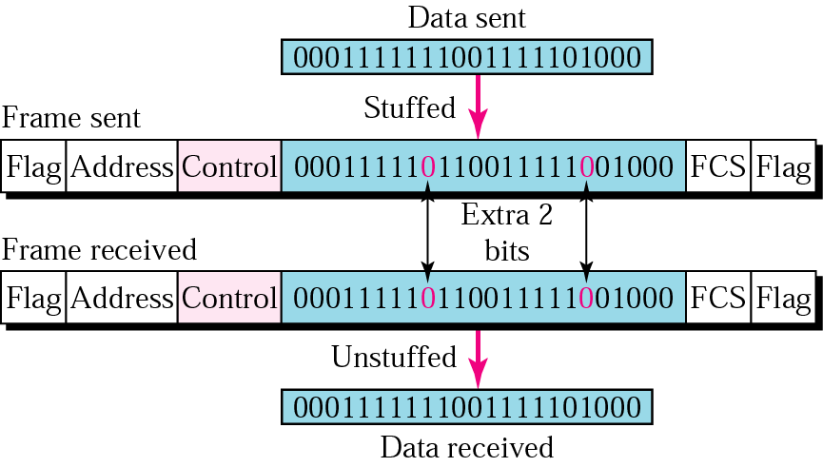
Bit stuffing and removal
Acadimic Purpose Only (KIET CN SKK IT VI)

Slide 47
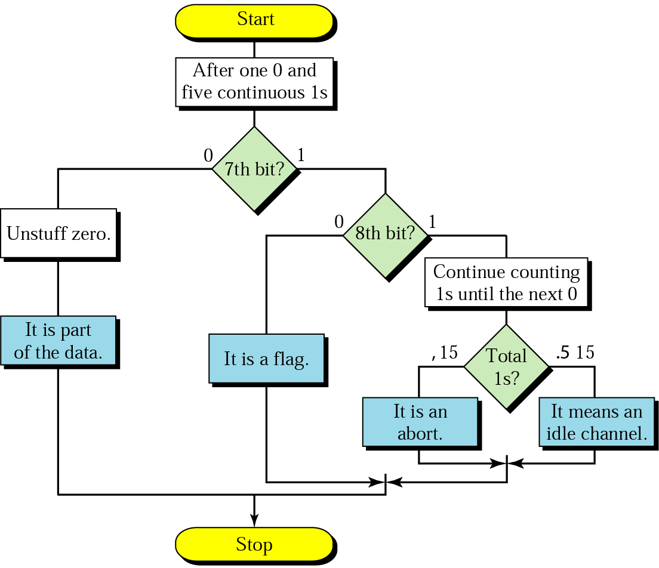
Bit stuffing in HDLC
Acadimic Purpose Only (KIET CN SKK IT VI)

